Slide 1





The Crisis
The Intelligence
The Experience
The Vision

Slide 2




THE ECONOMIC & INFORMATION GAP
THE ECONOMIC BARRIER
Average consultation fees of ₹300-800 represent a full day's wage for 500M+ Indians. This results in:
65% of rural Indians delay visits until emergencies.
Unnecessary out-of-pocket spending on "guessing" specialists.

Slide 3
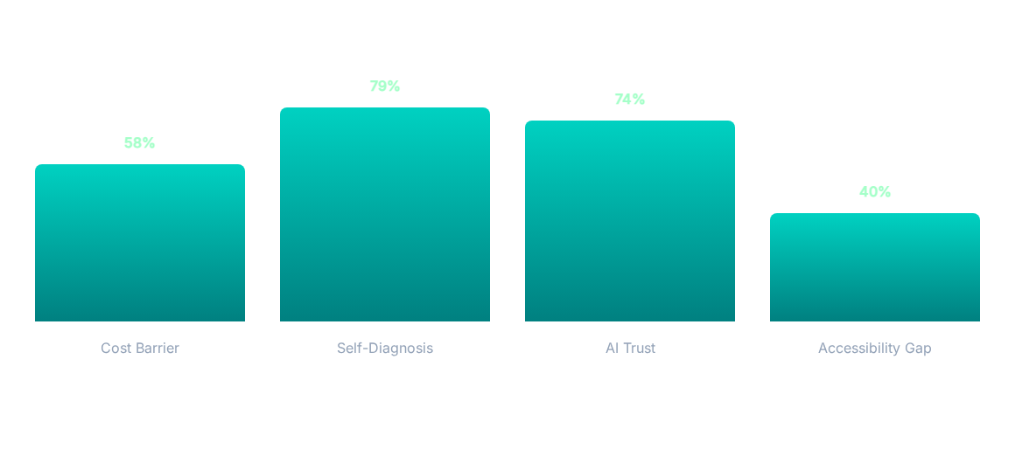
PRIMARY RESEARCH INSIGHTS
Source: Primary Survey, Aarogya AI Research Group, 2026. Survey of rural/semi-urban households.

Slide 4





WHY EXISTING SOLUTIONS FAIL
INFORMATION OVERLOAD
SPECIALIST MISMATCH
FINANCIAL FRICTION
High upfront costs prevent early detection, leading to avoidable complications and higher long-term costs.
Search engines create anxiety rather than clarity, offering contradictory data without triage.
Platforms show all doctors but don't guide you to the right one for your specific symptoms.

Slide 5
99.3% ACCURACY PERFORMANCE
99.3%
RIGOROUS VALIDATION
4,920 Clinical Cases analyzed.
41 Distinct Diseases predicted.
MODEL ACCURACY
132 Symptom combinations mapped.
Achieved by Naive Bayes classifier across 205 benchmarked model configurations.

Slide 6



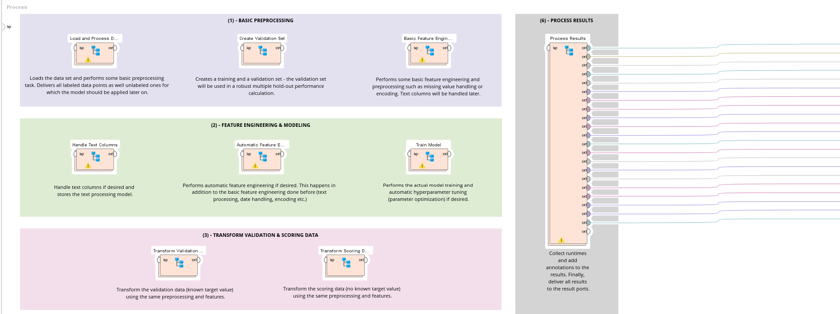




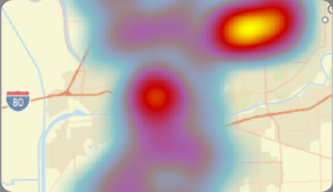
TECH STACK & INTELLIGENCE BACKBONE
RAPIDMINER AI
MENDIX STUDIO
Geoapify API
Advanced preprocessing and feature engineering.
Enterprise-grade application architecture.
Live clinic discovery powered by real-world location data. Hardcoded to Nagpur pilot zone, phase 2 adds dynamic GPS.

Slide 7

CLINICAL VALIDATION STANDARDS
VALIDATION METRICS
Zero Critical False-Negatives for emergency symptoms (chest pain, breathlessness).
Benchmarked against Gemini Advanced medical reasoning for edge cases.
0.7% Classification Error — Clinical Grade performance.

Slide 8
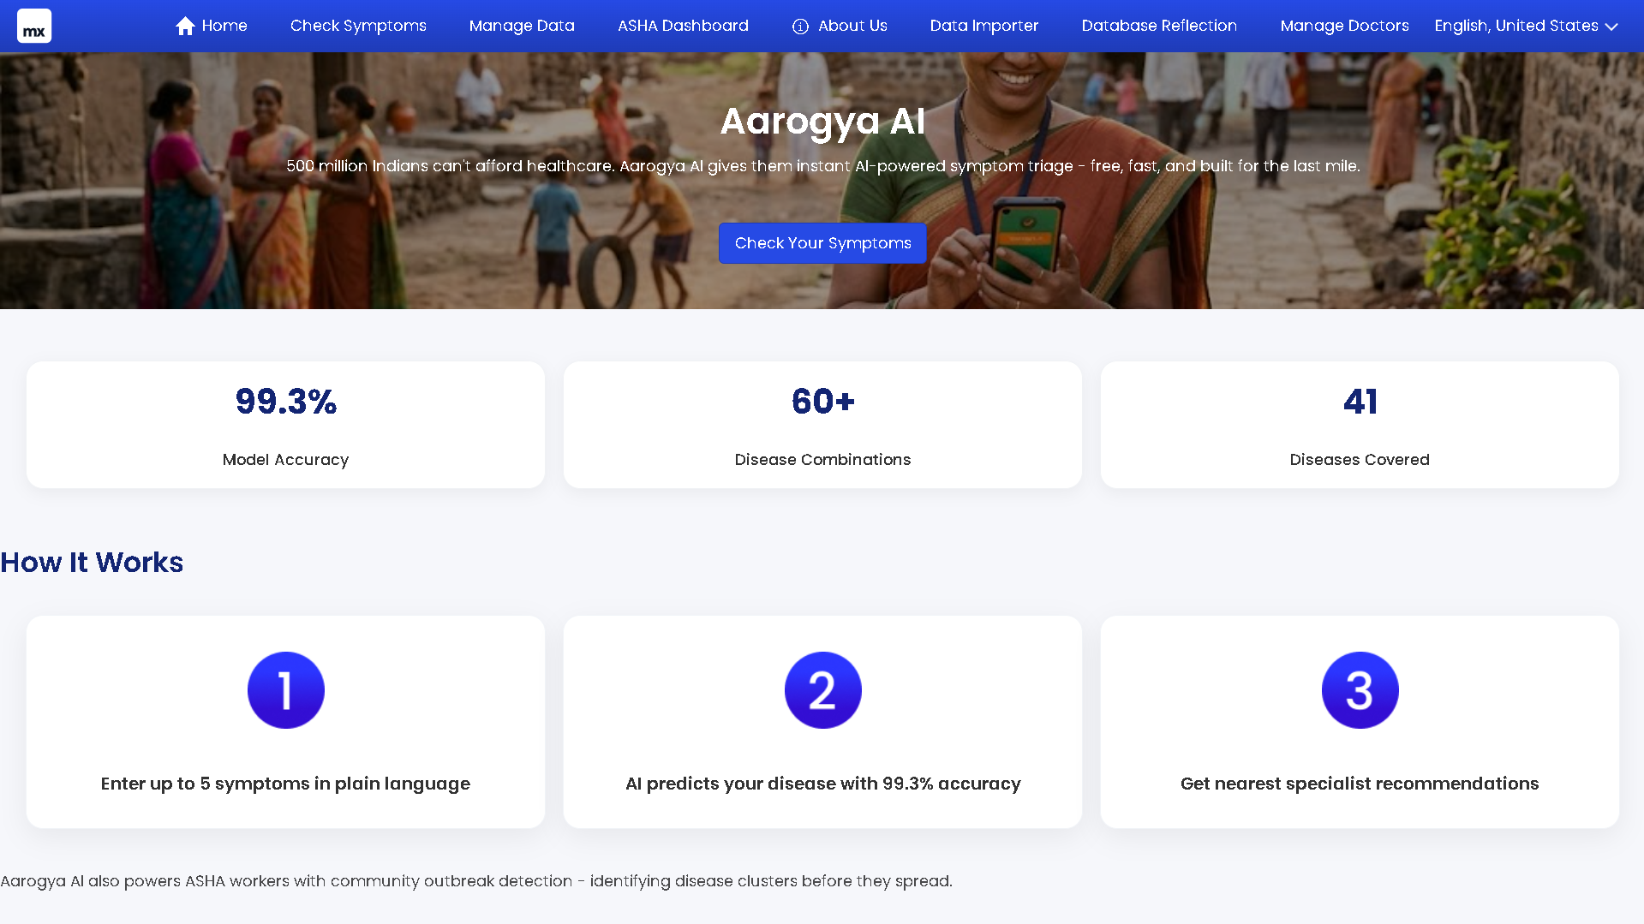

A UNIFIED ECOSYSTEM
Aarogya AI connects patients, clinics, and health workers in a single intelligence layer.
Symptom Triage: Tell us how you feel; we tell you the urgency.
Doctor Discovery: Find specialists nearby, sorted by distance and price.
Community Health: Outbreak detection alerts for ASHA workers.

Slide 10
SYSTEM ARCHITECTURE & PIPELINE
SYMPTOM INGESTION
DATA ORCHESTRATION
PREDICTIVE MODELING
GEOGRAPHIC ROUTING
PATIENT TRIAGE
Patient inputs up to 5 symptoms via Mendix interface. Works on 2G/low-data networks with no registration required.
Symptom data is structured, cleaned, and demographically profiled before being passed to the AI engine.
Naive Bayes classifier maps 132 symptom combinations across 41 diseases, achieving 99.3% accuracy.
Geoapify API identifies nearest clinics and specialists, sorted by distance and consultation price.
Clear verdict delivered: Home Care or See Doctor, with a matched specialist recommendation attached.

Slide 11
USER JOURNEY: UNDER 60 SECONDS
01. OPEN APP
02. SYMPTOMS
03. ANALYSIS
04. TRIAGE
05. FIND DOCTOR
No registration required; works on 2G/low data.
Input up to 5 symptoms in plain language.
Naive Bayes analysis in under 1 second.
Clear action: See Doctor vs Home Care.
Nearest specialist matched to condition.

Slide 12

MULTI-DIMENSIONAL SOCIAL IMPACT
40% VISIT REDUCTION
Lowering the burden on public healthcare systems by filtering non-serious conditions for home care. (Based on primary survey data. Target outcome for Phase 2 validation.)
₹2,000–₹5,000 ANNUAL SAVINGS
Redirecting household income from unnecessary consultation fees to nutrition and education.
OUTBREAK SURVEILLANCE
Early warning signals for local health authorities to prevent epidemic-level transmission.

Slide 13





THANK YOU
We appreciate your time and review.
Scan to view our GitHub Repository
THE AAROGYA AI TEAM
Rishit Kumar Gautam
IIT Mandi • Xpecto '26 Submission
https://github.com/rishitgautam8-commits/aarogya-ai

